Slide 1
Eda Project datalıst
Semih Abi
Ömer Faruk
Kadir
Muhammed
Serkan

Slide 2
Project Time Line
Sprints :
- Data cleaning
(07/02 - 14/02)
- Dealing with missing values
(14/02 - 21/02)
- Dealing with outliers
(21/02 - 28/02)

Slide 3
Tools
-Python (Pandas)
-Regex
-Colab
*Datalist Colab
*CleanedNan_values
*Outliers
-File format >> Pickle

Slide 4
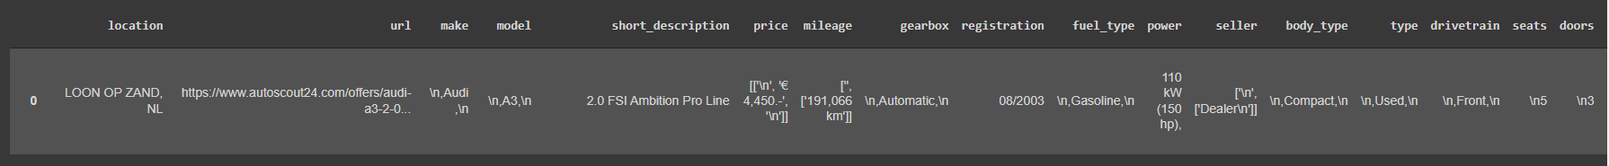
Our row data
Auroscout24.com

Slide 5
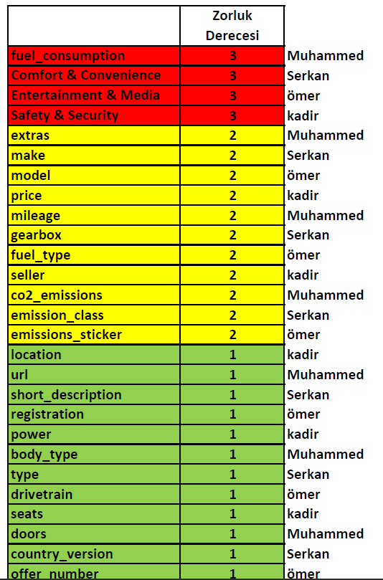
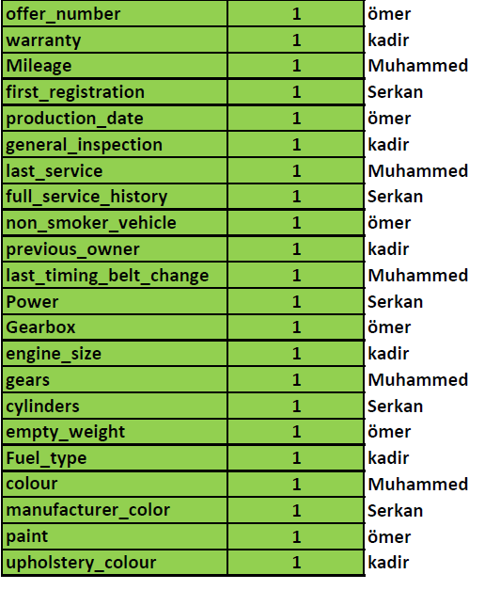
Work Sharing

Slide 6
Dropped dublicate and ambiguous features

Slide 7
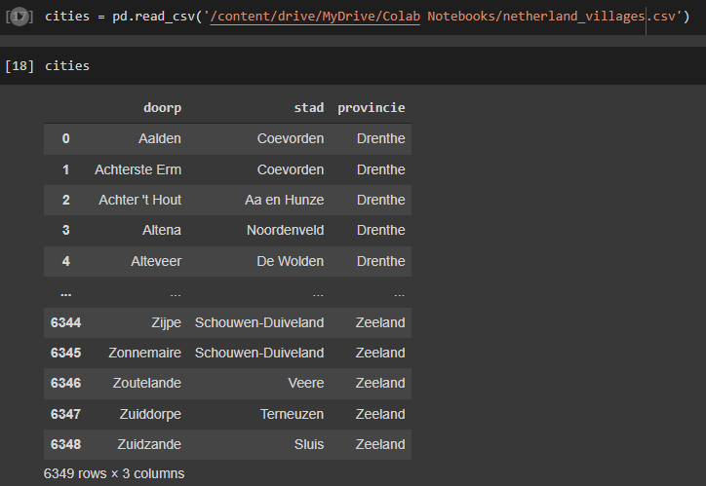
Sprınt – 1
We cleaned data from symbols and \n with regex
Feature Engineering
- Province

Slide 8

Province
Some locations was written stad name instead of location

Slide 9
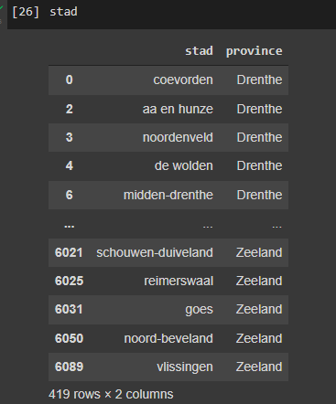

Sprınt – 1
Province
It was 5918 nan.

Slide 10
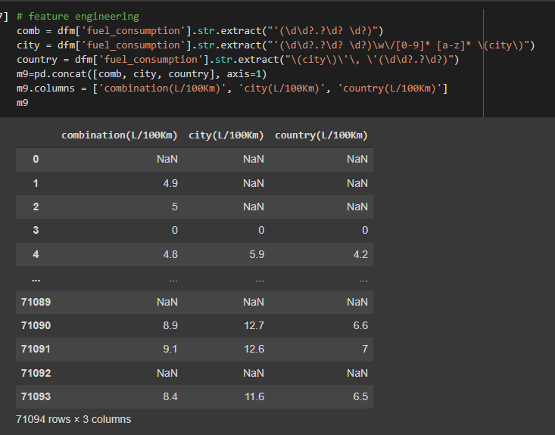
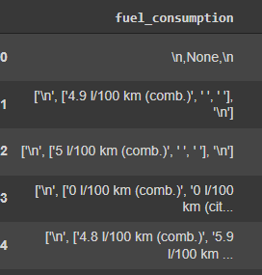
Sprınt – 1
Fuel_consumption
m

Slide 11

Sprınt – 1
Make_model
Diversity deduction

Slide 12
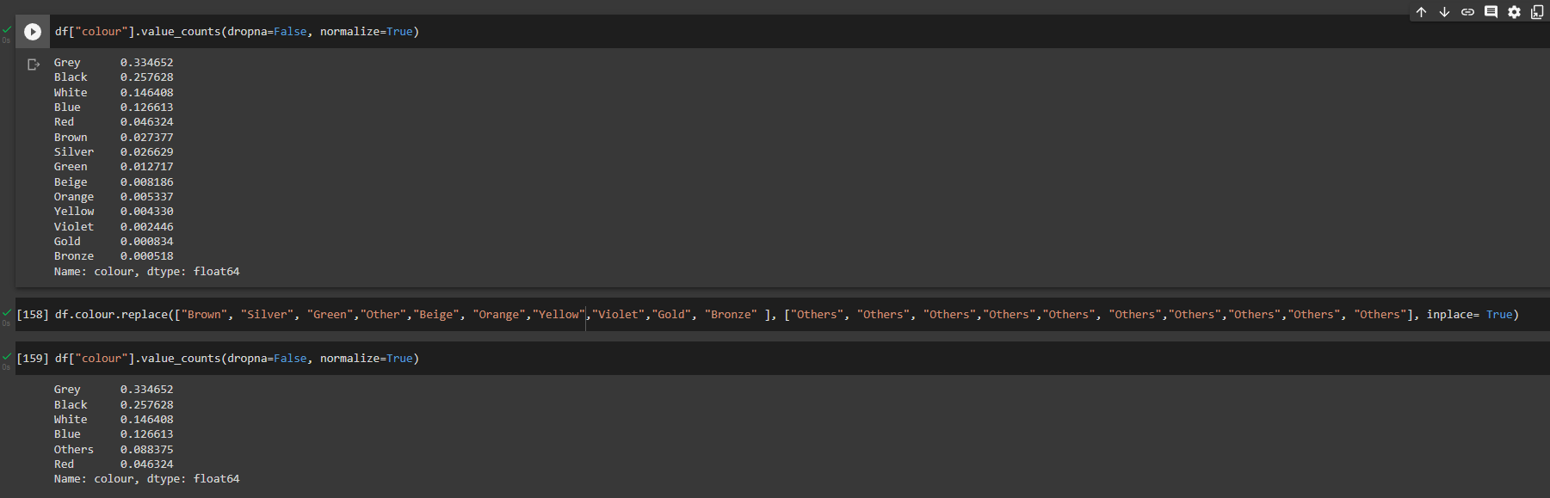
Sprınt – 1
Diversity deduction
m

Slide 13
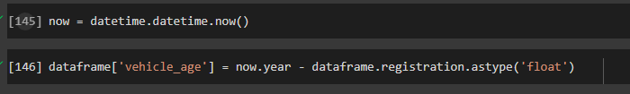
Sprınt – 1
Vehicle_age

Slide 14
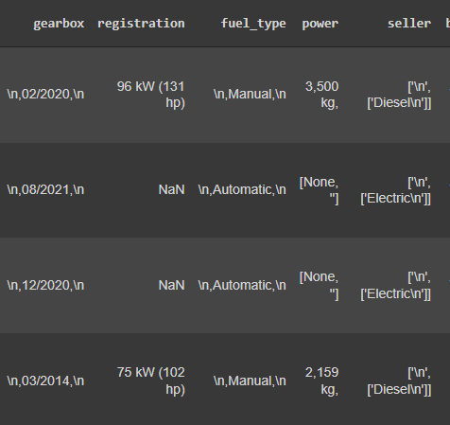
Problems ın sprint-1
Column – Value unpair
k

Slide 15
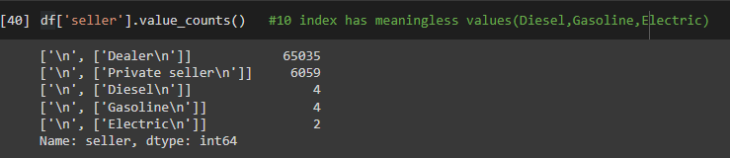
Problems ın sprint-1
Column – Value unpair
-How we discovered ?
k

Slide 16
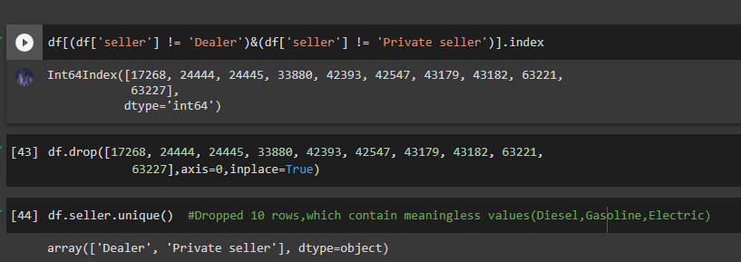
Problems ın sprint-1
Column – Value unpair
How we find that indexes :
Seller feature had 2 unique value without Null.
k

Slide 17

Problems ın sprint-1
*Unknowledge colab Works
*Regex forced us
s

Slide 18
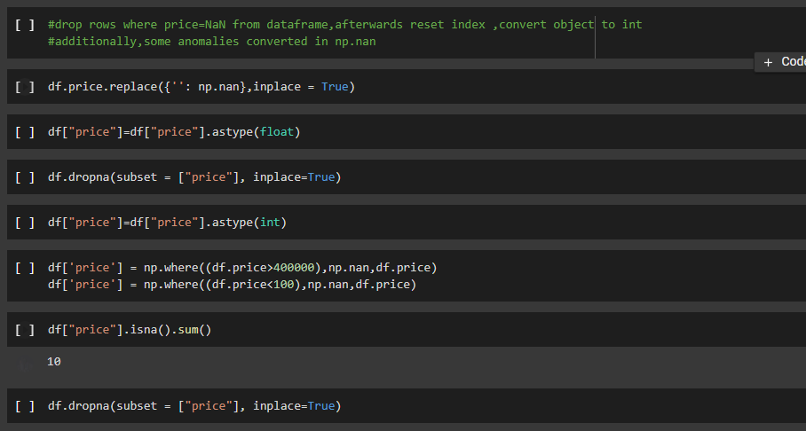
Sprınt – 2
Price drop nan values
k

Slide 19
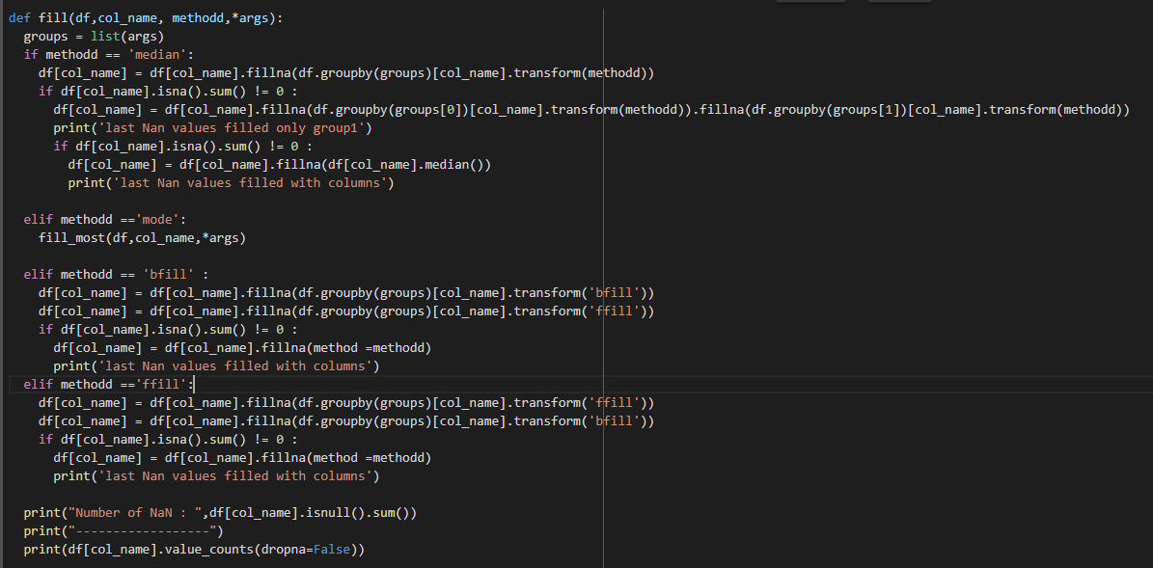
Sprınt – 2
Fill function is rewritten for performance

Slide 20
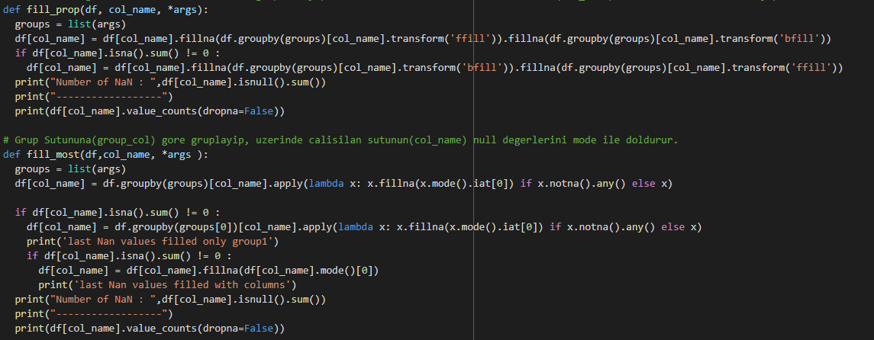
Sprınt – 2
Fill function is rewritten for performance

Slide 21
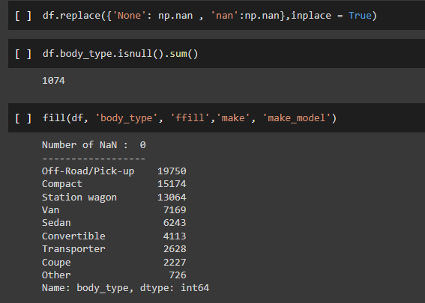
Sprınt – 2
Fill Nan values
m

Slide 22
Sprınt – 2
Fill Nan values
Electric and hydrogen type of cars
m

Slide 23

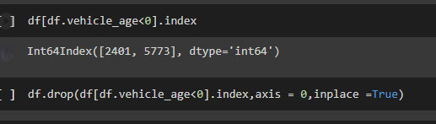
Sprınt – 2
Fill Nan values
-registration(New cars)
Registration was 2028 and 2025 .Invalid values

Slide 24
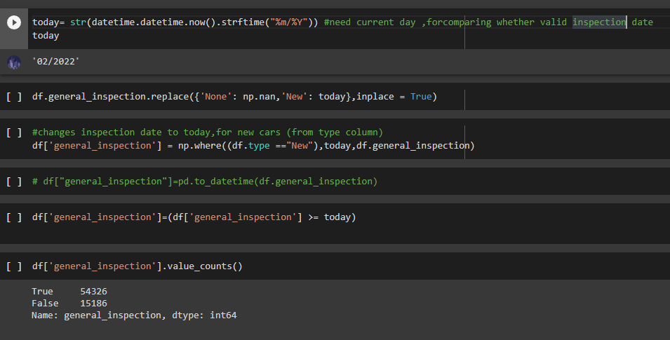
Sprınt – 2
Fill Nan values
General_inspection
k

Slide 25
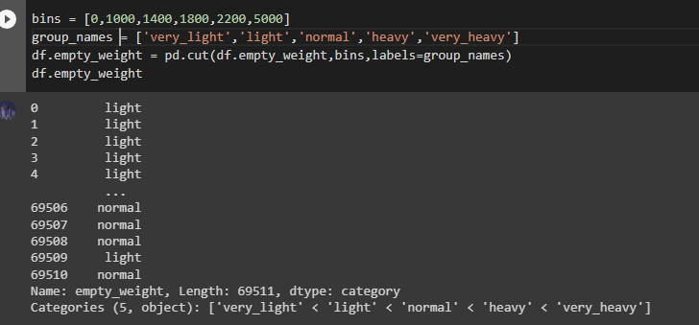
Sprınt – 3
Dealing with outliers
-empty_weight

Slide 26
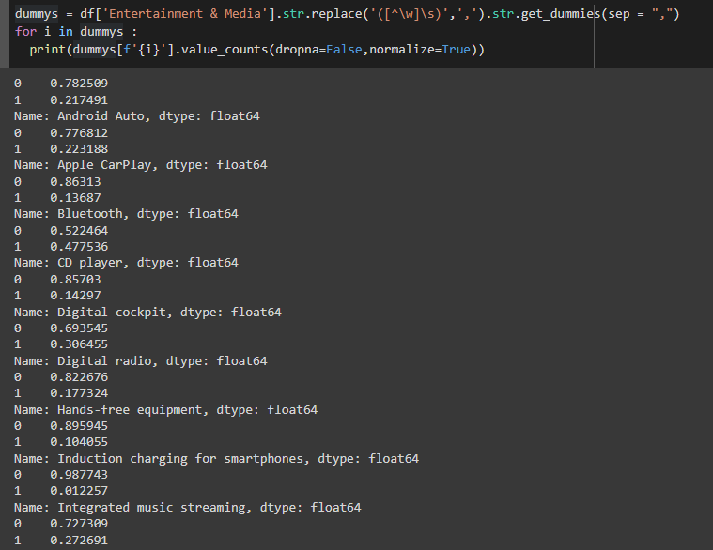
Sprınt – 3
One Hot Encoding
Checking
frequency rate 0.001

Slide 27
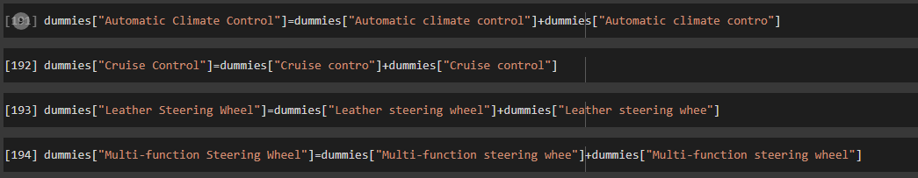
Sprınt – 3
Dummies feature problems
S

Slide 28
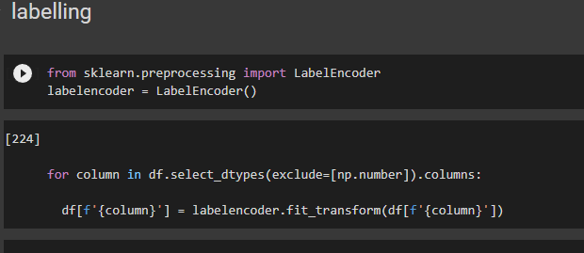
Sprınt – 3
Label encoding

Slide 29
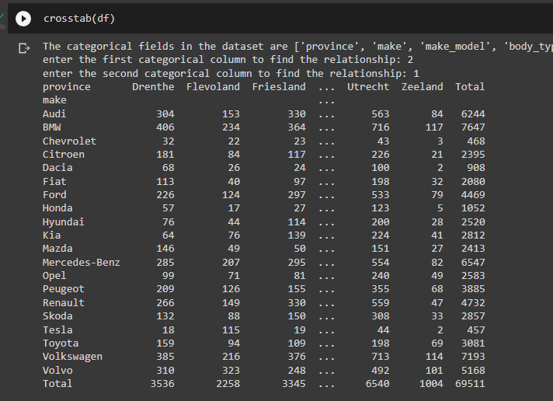
Sprınt – 3
crosstab

Slide 30
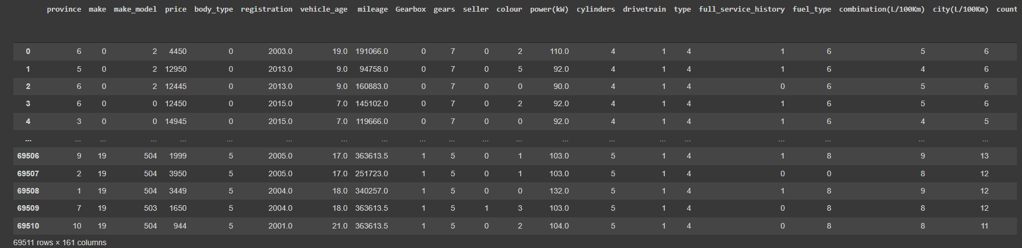
Ready for m.L model
Thank you

